Slide 1
A feature location approach supported by time-aware weighting of terms associated with developer expertise profiles
Submitted by: Sima zamani, sai peck lee, ramin shokripour and john anvik
Presented by: rajat sarin

Slide 2
Introduction (1/2)
Feature Location: Aims to identify the initial source code location associated with the implementation of a software feature
The text data in the repositories have a corresponding set of metadata, such as developer information, time stamp, and commit comments that explain the who, when, and why of the data
Text data can be analyzed from various perspectives such as source code location or developer.
In a developer-based approach, the term that had been used by different developers has more impact in determining the relevancy of the change request and a source code file.

Slide 3
Introduction (2/2)
A time-based approach, adjusts several weights to the term depending on the various times at which the term was used in the source code file.
Although this type of term weighting is highly accurate, it can also be complex and time-consuming.
Alternative technique used in the current work, is to weight the term only based on the most recent time that the project’s developer used the term in the source code file.
In this research, a feature location approach is proposed that analyzes the data stored in source code files from the perspective of the developer by considering the latest time of usage of the similar context in the developer expertise profiles

Slide 4
Time-aware Developers’ Expertise analysis for Feature Location (TDEFL)
In this approach, text data are extracted from the source code repository of a project and processed to create developer expertise profiles for use in identifying the feature location(s) for a new change request.
In order to assess the accuracy, performance, and effectiveness of TDEFL, an experimental evaluation was conducted on four open-source projects; JDT, AspectJ, NetBeans, and Rhino.
TDEFL relies on three functional components: Corpus creation, Term-weighting and Location identification

Slide 5
Corpus creation component(1/2)
To create a TDEFL corpus, first the required data are collected from the project’s Version Control System (VCS).
The identifiers which are used to identify the source code entities, such as files and classes, are extracted from the entire history of the project’s source code.
From the extracted identifiers, the names of classes, methods, fields, and method parameters are used.
To create the corpus, the identifiers are also decomposed which results in a set of terms from which the identifiers are formed, hereafter referred as decomposed identifiers.

Slide 6
Corpus creation component (2/2)
Only the noun terms of the decomposed identifiers are used in order to reduce the volume of data.
Furthermore, the terms that contain symbols, digits or have less than three characters are filtered from the set of terms.
The terms are then lemmatized in order to reduce the different forms of a term.

Slide 7
Term-weighting component
In this component, the preprocessed data from the corpus creation component are weighted to determine the similarity of the source code files with the given change request.
Similarity of the source code files is determined through analyzing the developer expertise profiles for the files that are derived based on the vocabularies and terms that are recorded in the logs of the developers’ activities.
The weight of a term is determined based on its importance among the other terms associated with the developer who worked on the source code file over time.

Slide 8
Location identification component(1/2)
The relevancy of the new change request with the developer’s activities on a file is determined based on the weights of the common terms that were appeared in both the new change request and the developer expertise profiles for a file.
Since, for a source code file, it is possible that more than one developer have relevant activities for the new change request, the final score of the file needs to be determined by the summation of the calculated expertise scores of the developers who used the term in the file.

Slide 9
Location identification component (2/2)
The source code files are then sorted in descending order based on the final scores. The output of this component is a ranked list of files in descending order of relevancy.
In this list, files ranked at the top of the list have a higher similarity with the given change request than those ranked lower in the list.

Slide 10
Evaluation setup: Context selection (1/2)
To select the test sets of bug reports for experimentally evaluating the proposed approach, all the change requests reported to the issue tracking system (ITS) of the subject systems were investigated.
For this study, from the change requests of each subject systems, 200 change requests that were marked as FIXED were randomly selected as the main test set to evaluate the proposed approach.
The reports were chosen randomly to avoid evaluating the approach in a specific period of the project lifecycle where confounding conditions may occur.

Slide 11
Evaluation setup: Context selection (2/2)
Also, to assess the behavior of the approach in specific periods of the project lifecycle, the subject systems were investigated to select new test set from two specific periods.
The first 100 fixed change requests that were reported to the subject systems formed an “early” test set and similarly the most recent 100 fixed change requests, at the time of data collection, formed a “late” test set.

Slide 12

Comparable feature location approaches
To investigate the accuracy of analyzing the source code data from the developer perspective, the results of the proposed approach are compared to approaches that used SUM and VSM, which are location-based feature location methods.
TDEFL results are compared with NBFL as a time-based feature location approach.
the results of TDEFL were compared with 2 versions of DBFL; one that does not take into account the time-metadata of developers’ activities (termed as DEFL)and second that does not have developer frequency parameter (${\text{DEFL}}_{(\text{No}\text{−}\text{Keywords})}$)

Slide 13
Vector Space Model
VSM analyzes text documents in a training set and measures their similarity with a query in three steps:
VSM makes a vector of the terms used in each of the documents
The weights of the terms are determined for each document.
The cosine similarity of document vectors against a vector for the query is calculated and the documents are indexed based on their similarity with the query.

Slide 14
Smoothed Unigram Model
The Unigram Model (UM) is a simple case of a language model where the probability of each term is determined independent of other terms.
The problem of UM assigning a zero probability to a class that is missing one term of a query is resolved in the Smoothed Unigram Model (SUM) by measuring the probability of a term in all documents instead of a single document

Slide 15
Research questions
The research questions that we aim to address in this research are as follows:
Does the use of developer expertise profile result in a more accurate feature location approach than the state-of-the-art IR approaches?
What is the impact of using time-metadata in a developer-based feature location approach?
Extending from these research questions, the following set of hypotheses were identified based on the accuracy and effectiveness metrics

Slide 16

Hypotheses for rq 1
The null hypotheses from the first research question are as follows:
$H_{\text{0}\text{,}\text{TDEFL} \text{vs} \text{SUM}}$: There is no significant difference between TDEFL, and SUM.
$H_{\text{0}\text{,}\text{TDEFL} \text{vs} \text{VSM}}$: There is no significant difference between TDEFL and VSM.
$H_{\text{0}\text{,}\text{TDEFL} \text{vsNBFL}}:$There is no significant difference between TDEFL and NBFL

Slide 17

Hypotheses for rq 2
The null hypotheses from the second research question are as follows:
$H_{\text{0}\text{,}\text{TDEFL} \text{vs} \text{DEFL}}$: There is no significant difference between TDEFL and DEFL.
$H_{\text{0,}\text{TDEFL} vs{ DEFL}_{(No−Keywords)} }$: There is no significant difference between TDEFL and ${DEFL}_{(No−Keywords)}$.

Slide 18
Metrics for Experimental design (1/2)
Top N Rank or Likelihood: This metric is used to evaluate the accuracy of a feature location approach. In this case, the higher the value of the metric, the better the accuracy of the feature location approach.
Effectiveness: In feature location, effectiveness is defined as the position of the first relevant source code location in the ranked list. For this metric, the lower the value, the less effort is required by the developer, leading to a more effective feature location approach.

Slide 19
Metrics for Experimental design (2/2)
Mean Reciprocal Rank (MRR): MRR is the inverse of the effectiveness metric. The higher the MRR value, the better the performance of the feature location approach.
Mean Average Precision (MAP): The MAP is the mean of the average precisions for a set of queries. Precision is the fraction of predicted source code locations that are relevant to the given query. The higher the MAP value, the better the feature location performance

Slide 20
Data collection and preparation
To collect the data from the VCS, the commit log was first downloaded from the VCS.
In order to extract the identifiers from the collected data, first, the source code files that were created or modified in each revision were regenerated using the appropriate VCS commands.
Next, the source code files are converted into a tagged format, specifically into JavaDocXML.
From the generated XML files, the text entities of the <jelclass>, <fields>, <method>, and <params> tags were extracted to collect the names of classes, fields, methods, and method parameters

Slide 21
Data collection and preparation
In the next step, decomposing identifiers, was used to produce the set of terms used to create identifiers.
To extract the noun terms from the decomposed identifiers, a plug-in of GATE13 was employed.
Then, the part-of-speech (POS) tagger of the ANNIE plug-in was used to determine the roles of the decomposed identifiers to extract the noun terms.

Slide 22
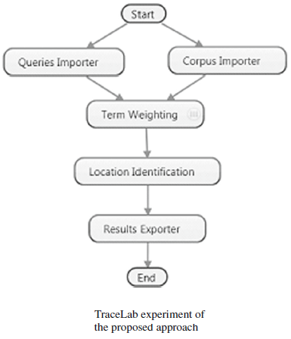
Experimental implementation (1/2)
All refined data were used as the input to the experiment. These data were imported using the Corpus Importer components created by Moritz and his colleagues.
In parallel, the text of the summary and description fields of a new change request were entered into the experiment through the Queries Importer component as a query.

Slide 23
Experimental implementation (2/2)
Using the imported data, the weights of the terms that appeared in both the developer expertise profile and the query were calculated by the term weighting component.
The scores of the source code files were determined in the location identification component.
The output of this experiment was a ranked list of source code files in descending order of the scores that were retrieved by the Results Exporter component

Slide 24
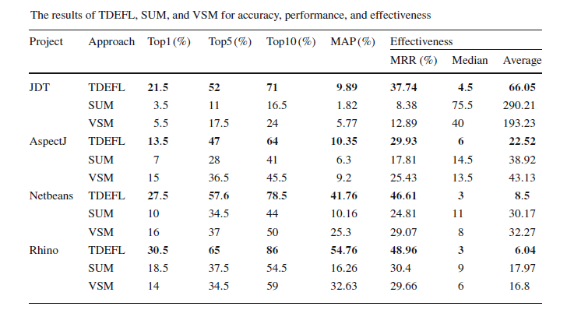
Evaluation results and analysis

Slide 25
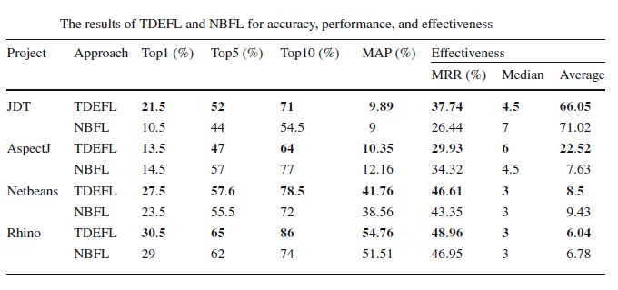
TDEFL versus NBFL

Slide 26
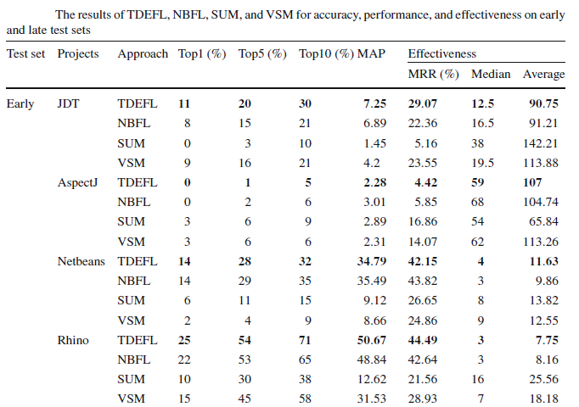
Evaluating for a Specific Time Period

Slide 27

Discussion (1/6)
The experimental evaluation of the proposed developer-based approach on the main test set indicates that TDEFL obtained better results in all respects, i.e., accuracy, performance, and effectiveness, when compared to SUM and VSM.
The statistical analysis of the accuracy and effectiveness metrics on the main test set of the experiment indicates significant differences that lead to the rejection of $H_{\text{0}\text{,}\text{TDEFL} \text{vs} \text{SUM}}$ and $H_{\text{0}\text{,}\text{TDEFL} \text{vs} \text{VSM}}$
Accordingly, the corresponding alternative hypotheses are supported with respect to the significance of the differences between TDEFL and SUM and VSM.

Slide 28
Discussion (2/6)
The further evaluation of the proposed approach on the test sets selected from specific periods of project lifetime, i.e., early and late test sets, indicates the outperformance of TDEFL on all the subject systems with one exception.
The result of the baseline approaches on the early test set of the AspectJ project is slightly better than TDEFL.
This exception is due to the low number of developers working on the AspectJ project

Slide 29
Discussion (3/6)
The effect of considering the changes of the developers’ activities over time in the proposed approach with and without time consideration was analyzed.
This experiment showed the superiority of TDEFL on JDT, AspectJ, and NetBeans.
On the Rhino project, consideration of time did not improve the accuracy due to the slow evolution speed of the project.

Slide 30
Discussion (4/6)
Investigating the results for comparing TDEFL and NBFL shows that considering time in both the location-based and developer-based feature location approaches has a positive effect.
Also, the comparison of the results for TDEFL and NBFL shows an improvement in all aspects for the subject systems with two exceptions.
First, the experiment on all the test sets, i.e., random, early and late test sets for the AspectJ project shows that NBFL performs better than TDEFL.

Slide 31
Discussion (5/6)
The second exception is related to the NetBeans project. The results of the TDEFL and NBFL for this subject system are close, and in one case for the early test set, the result of NBFL is slightly better than TDEFL.
Further investigation of this project revealed that the number of developers to the source code files of the project was very high. The high ratio of the developers lead to a small size of classes for the data stored in the source code files.

Slide 32
Discussion (6/6)
The execution time of the TDEFL approach is significantly lower than that of NBFL. For example, the execution time of NBFL and TDEFL on JDT is 2302 and 1445 seconds, respectively.
The experiment revealed that DEFL outperforms the accuracy of both SUM and VSM by as much as 47 and 40%, respectively

Slide 33
Question
What are the possible threats to this research?

Slide 34


